Slide 1
Software Version Control With GIT
Team:
20P31A1207- B. V. Nihar
20P31A1210- Ch.Vandana Devi
20P31A1217- G. Madhunadh
20P31A1237- N. Pavani Pravallika
Team : IT Elites

Slide 2
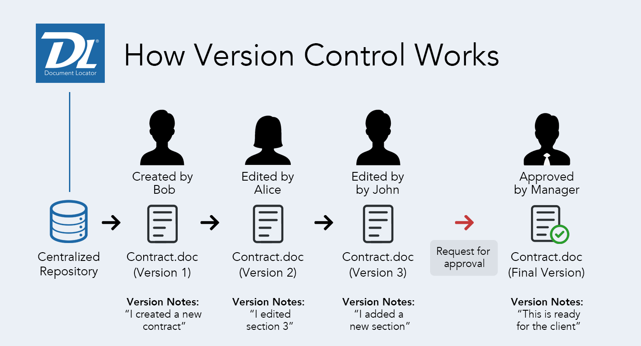
Introduction
01
What is Version Control System ?
Version control systems are a category of software tools that helps in recording changes made to files by keeping a track of modifications done in the code.
Why VCS is so important?
A version control system is a kind of software that helps the developer team to efficiently communicate and manage(track) all the changes that have been made to the source code along with the information like who made and what changes have been made.

Slide 3
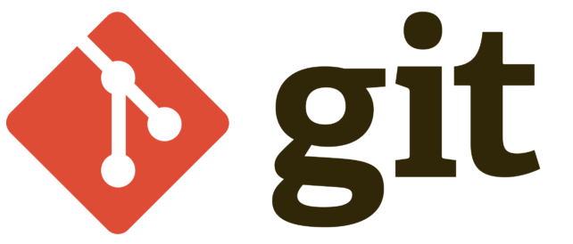
What is Git?
03
GIT, which stands for Global Information Tracker, used for software development and other collaborative projects. Git is a Version Control System or also known as VCS.
VCS is basically software designed to record changes within one or more files over time.
Why Git?
GIT, which stands for Global Information Tracker, used for software development and other collaborative projects. Git is a Version Control System or also known as VCS.
VCS is basically software designed to record changes within one or more files over time.
It’s for free and is open source.
Every user has his own copy of the repository data stored locally.
nearly every task in git is undo-able.

Slide 4
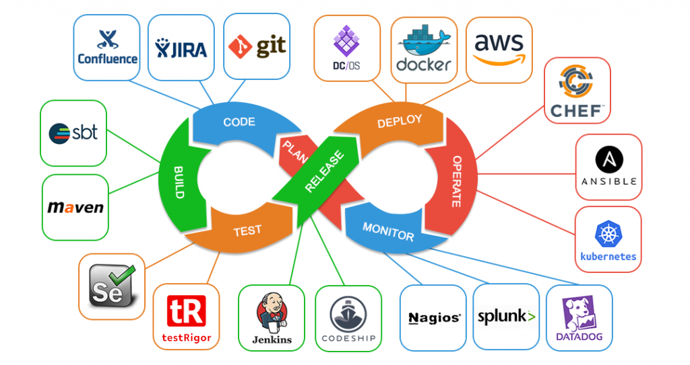
04
04
Continuous Integration and Continuous Delivery (CI/CD)
CI/CD is a method to frequently deliver apps to customers by introducing automation into the stages of app development.
Continuous Integration: The practice of Merging development work with the main branch constantly.
Continuous Delivery: Code is ready to deploy at the push of a button.

Slide 5

CI/CD Using Jenkins
05
Jenkins helps you to build and test your software projects thus it is a powerful application that allows continuous integration and continuous delivery of projects.
Jenkins integrates development life-cycle processes of all kinds, including build, document, test, package, stage, deploy, static analysis.

Slide 6





Companies using CI/CD
06
Facebook
Netflix
Udemy
Instacart
Robinhood
Twitch
LinkedIn
Delivery Hero

Slide 7
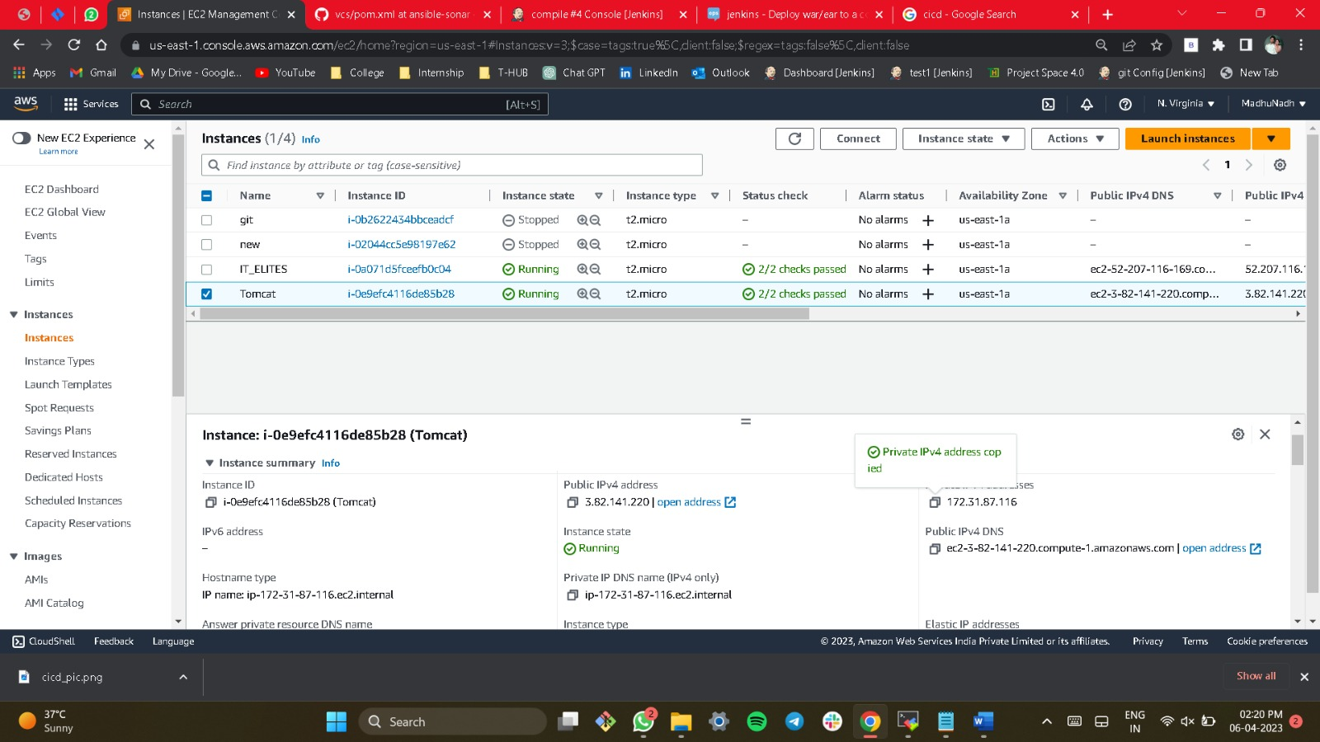
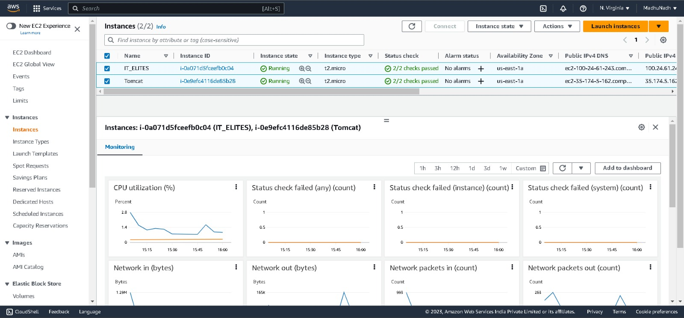
Implementation
Implementation
07
Requirements:
Creation of Instances in Virtual machine.
Git
Java
Maven
Jenkins
Apache Tomcat 9

Slide 8
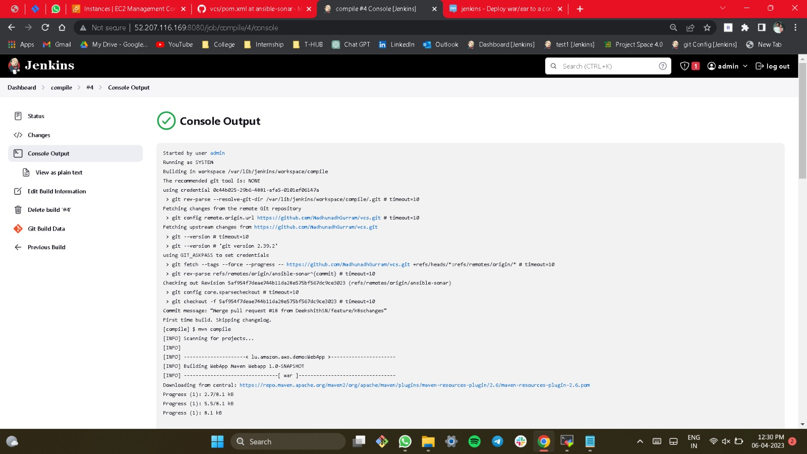
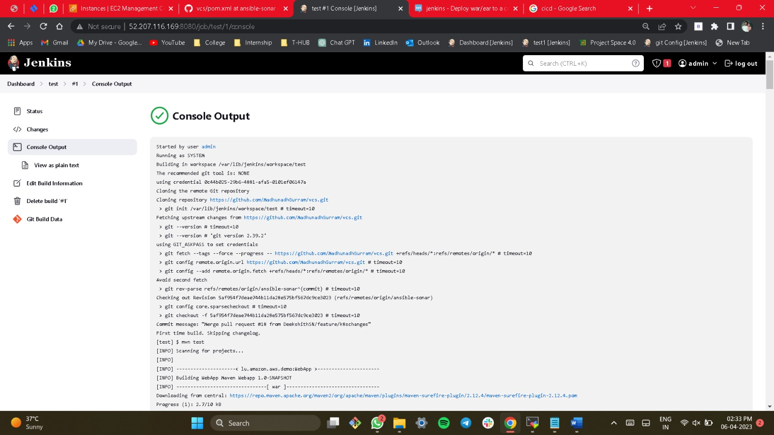
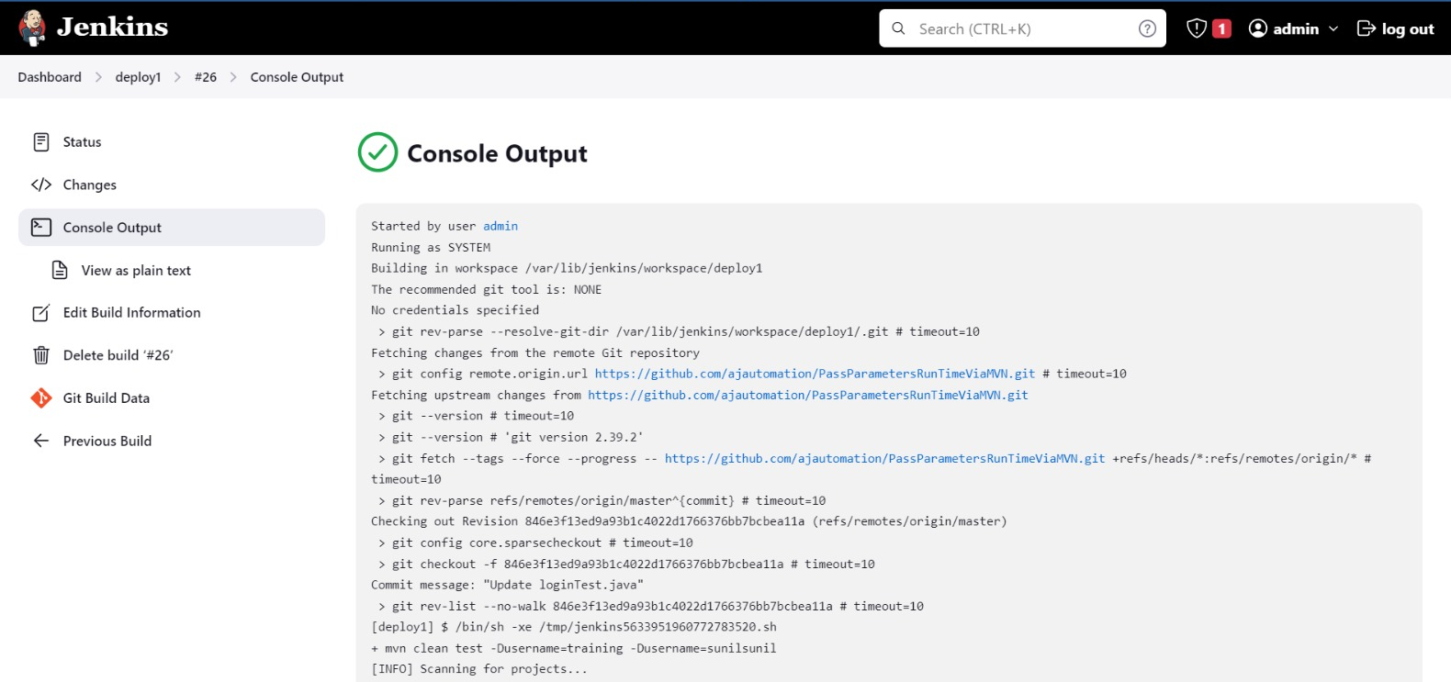
Compile
Test
08
Deploy

Slide 9

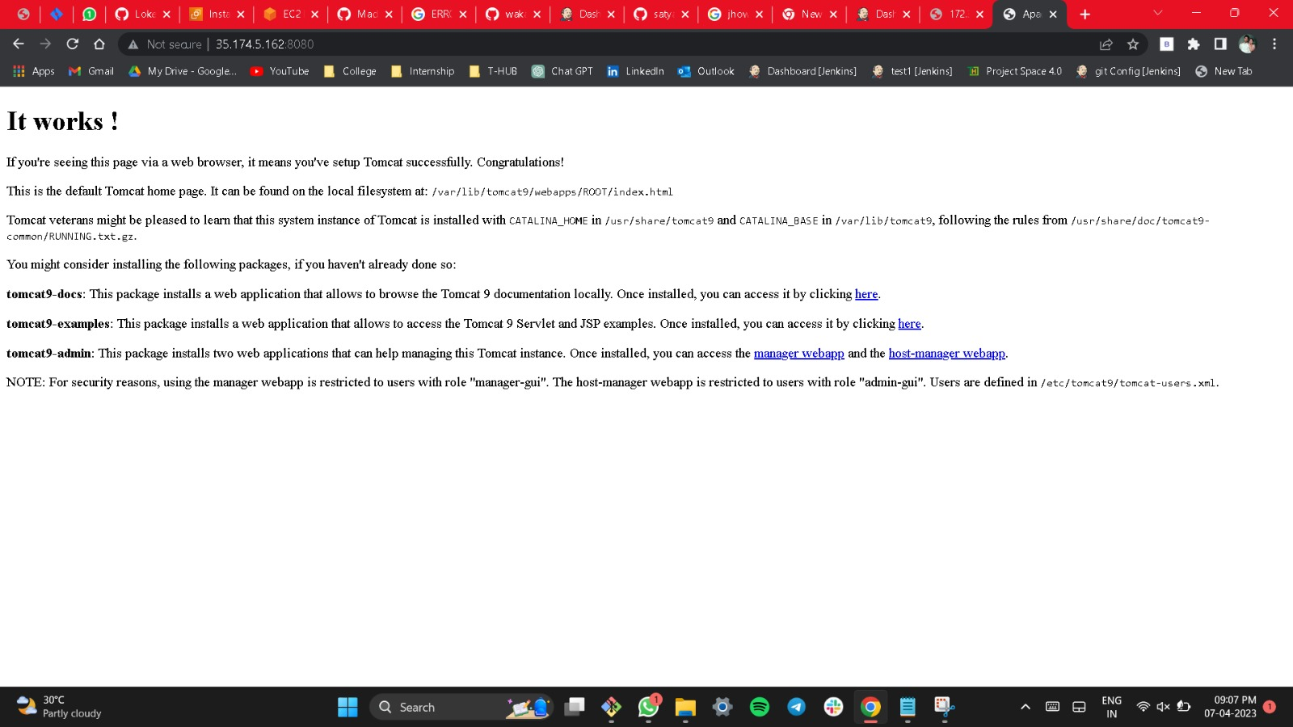
Conclusion
09
After all the implementation of the requirements, by giving the public IP of the instance where tomcat server is installed.
That url will be directed to the shown Image.
Url : http://IP:8080

